Slide 1
CREATE CHATBOT IN PYTHON
PHASE FOUR: development part two

Slide 2
INTRODUCTIONA TO AI CHATBOT
Were you ever curious as to how to build a talking
ChatBot with Python and also have a conversation
with your own personal AI?
AS the topic suggests we are here to help
a conversation with your AI today. To have a conversation
with your AI, you need a few pre-trained tools which can
you build an AI chatbot system. In this article, we will
to combine speech recognition processes with an .

Slide 3
THE ARCHITECTURE OF CHATBOT
Typical chatbot architecture should consist of the following:
Chat window/session/front end application interface
The deep learning model for Natural Language Processing [NLP]
Corpus or training data for training the NLP model
Application Database for processing actions to be performed by the chatbot
Please refer to the below figure to understand the architectural interface:

Slide 4

TOKENIZATIONA

Slide 5
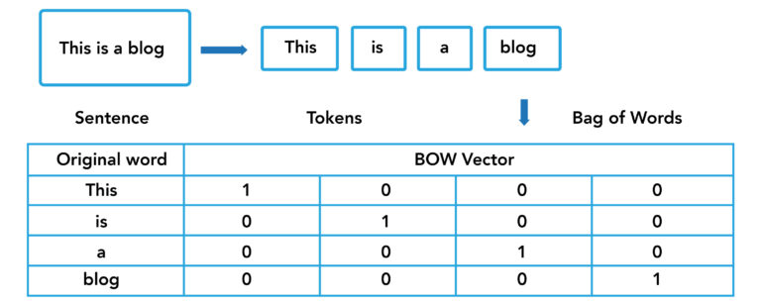
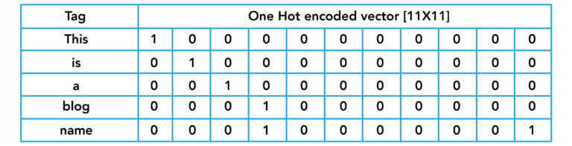

Slide 6
Algorithm for this text-based chatbot
Algorithm for this text-based chatbot
Input the corpus
Perform data pre-processing on corpus:
Text case [upper or lower] handling
Tokenization
Stemming
Generate BOW [Bag of Words]
Generate one hot encoding for the target column
Design a neural network to classify the words with TAGS as target outputs
Design a chat utility as a function to interact with the user till the user calls a “quit”
If the user does not understand or finds the bot’s answer irrelevant, the user calls a “*” asking the bot to re-evaluate what the user has asked
Run the chat utility function

Slide 7
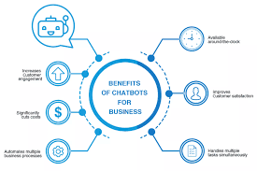

Slide 8
TRAINING SESSIONS
> hi 🪴
Welcome, friend 🤗
> hello 🪴 are you a plant? >
me?
🪴 are you a plant?
> yes 🪴 hi >
are you a plant? 🪴
No, I'm the pot below the plant!
> cool 🪴
Welcome, friend 🤗

Slide 9
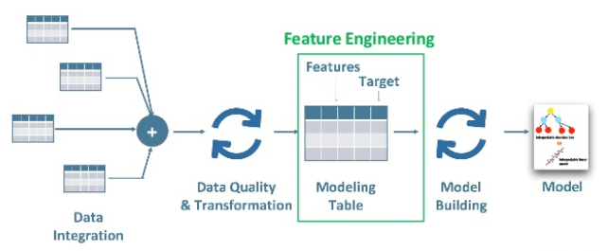

Slide 10
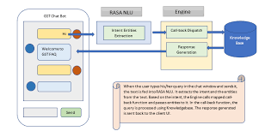

Slide 11
conclusions
A database is used in many applications for the connection of Chatbots.Every customer or user needs appropriate answers and so database is used to so that purpose can be solved. Human language can be transformed into the data transformation with the help of NLP. NLP helps to transform with a blend of text and patterns because of which it gets applicable responses. There are many NLP applications and programming interfaces and services that helps in development of Chatbots. And make it possible for all sort of businesses – small, medium or large-scale industries. The primary point here is that smart bots can help increase the customer base by enhancing the customer support

